Slide 1
IMDB Dataset Analysis*
ANR-Lab
12/2021
By Davydova Violetta and Sorokina Yulia
* Click to see more

Slide 2
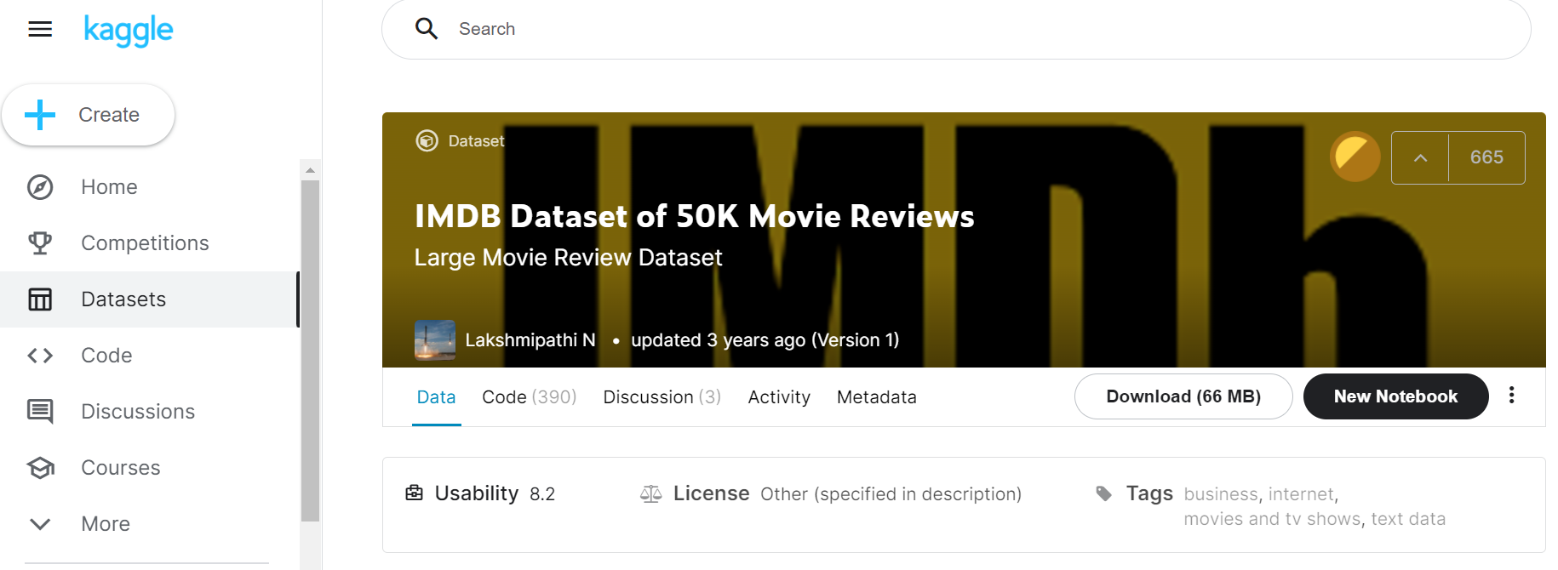
IMDB Dataset of 50K Movie Reviews from kaggle.com
ANR-Lab
IMDB Dataset Analysis
By Davydova Violetta and Sorokina Yulia

Slide 3
Objective of the project:
ANR-Lab
IMDB Dataset Analysis
By Davydova Violetta and Sorokina Yulia
clustering based on the results obtained by models (CBOW, Glove and Fasttext)
CBOW |  | Glove |  | Fasttext
+ | - | + | - | + | -
simple architecture | word-level learning: no information about sentence or context | simple architecture without a neural network | poorly handles unknown and rare words | relatively simple architecture: feed-forward, 1 input, 1 hidden layer, one output | word-level learning: no information about the sentence or context in which the word is used
learns quickly and generates embeddings | ignores the fact that a word can have different meanings depending on the context of use | the model is fast and this may be sufficient for simple applications | remains trained at the word level | (although n-grams add complexity to the generation of embeddings) | the co-appearance is ignored, that is, the model does not account for the different meanings of the word in different contexts
embeddings have meaning | doesn't handle unknown and rare words very well | meaningful embeddings | provides little data about the sentence and context in which the word is used | thanks to n-grams it works well on rare and outdated words | (so GloVe may be preferable)

Slide 4
ANR-Lab
IMDB Dataset Analysis
By Davydova Violetta and Sorokina Yulia
The Project implementation steps:
Preprocessing of Data (tokenization, delete stop words, stemmization)
Text Data Vectorization (Bag of words (BOW))
CBOW/Glove/Fasttext
Clustering implementation
Conclusions

Slide 5
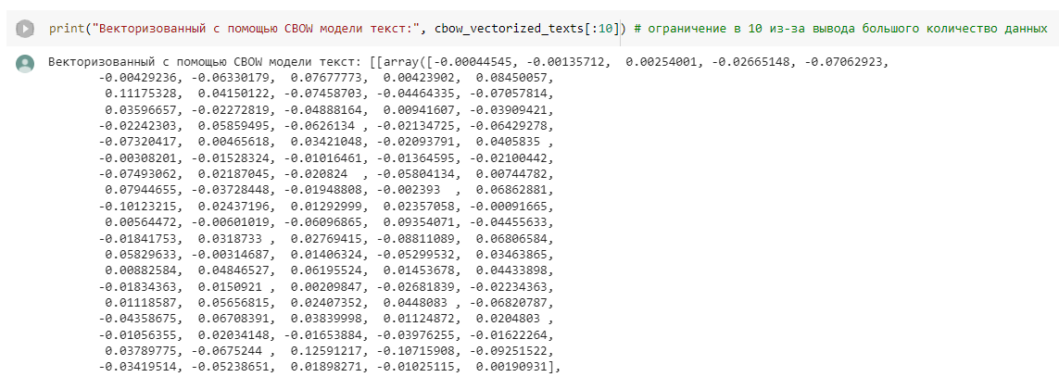
CBOW
ANR-Lab
IMDB Dataset Analysis
By Davydova Violetta and Sorokina Yulia

Slide 6
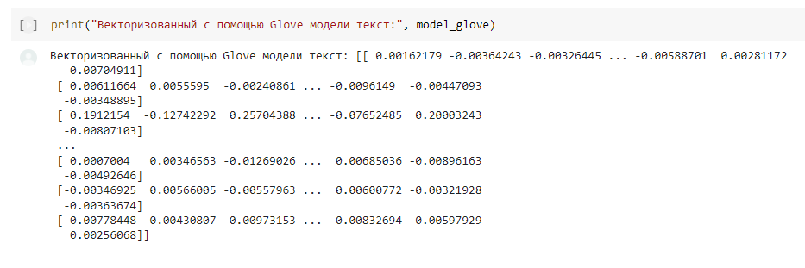
Glove
ANR-Lab
IMDB Dataset Analysis
By Davydova Violetta and Sorokina Yulia

Slide 7
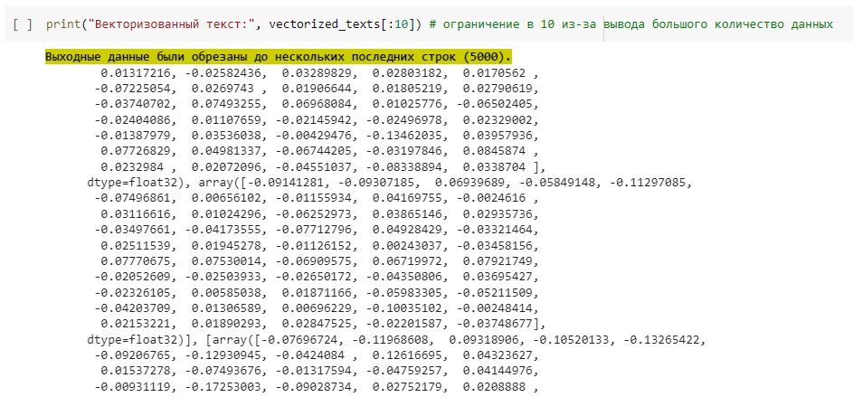
Fasttext
ANR-Lab
IMDB Dataset Analysis
By Davydova Violetta and Sorokina Yulia

Slide 8
K-Means Clustering
ANR-Lab
IMDB Dataset Analysis
By Davydova Violetta and Sorokina Yulia

Slide 9
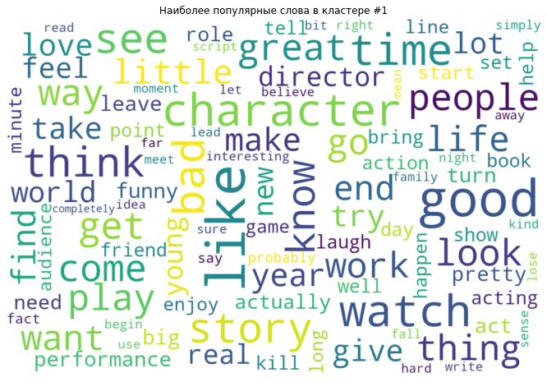
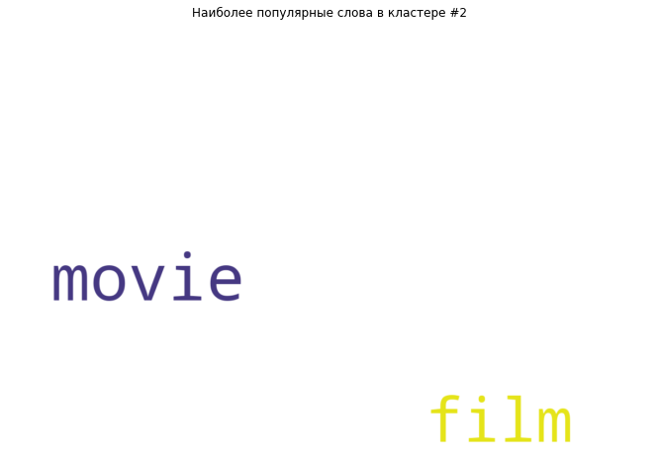
WordClouds
ANR-Lab
IMDB Dataset Analysis
By Davydova Violetta and Sorokina Yulia
Img. The more common word cloud image
Img. Word cloud image that is different

Slide 10
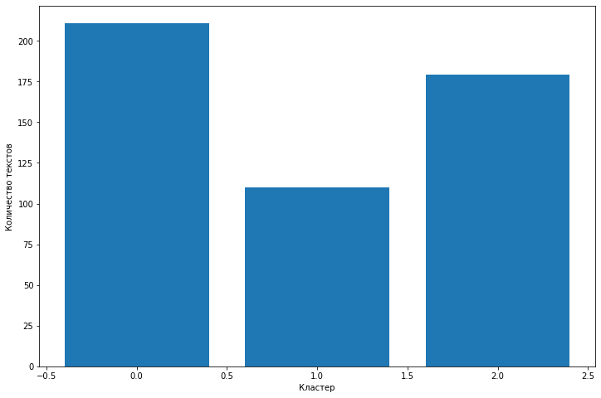
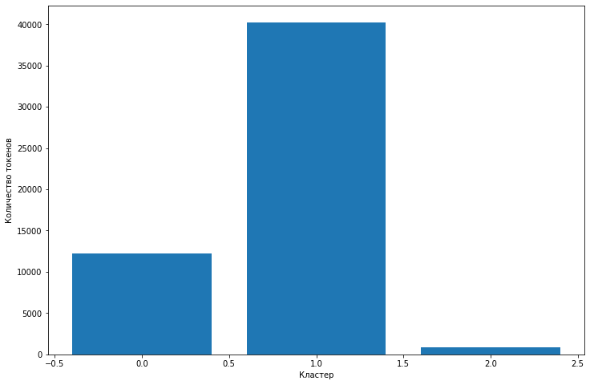
Frequency histograms
ANR-Lab
IMDB Dataset Analysis
By Davydova Violetta and Sorokina Yulia
Img. Histograms of the appearance of texts by clusters for the pretrained model
Img. Histograms of the appearance of tokens by clusters for the pretrained model

Slide 11
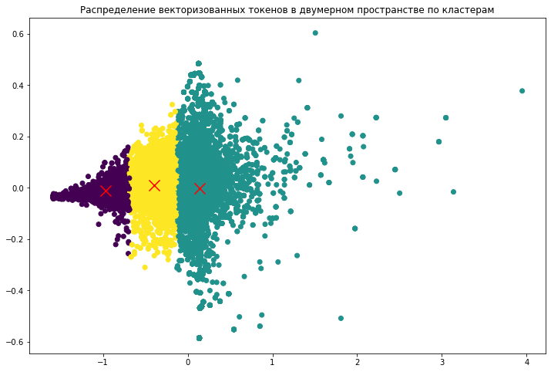
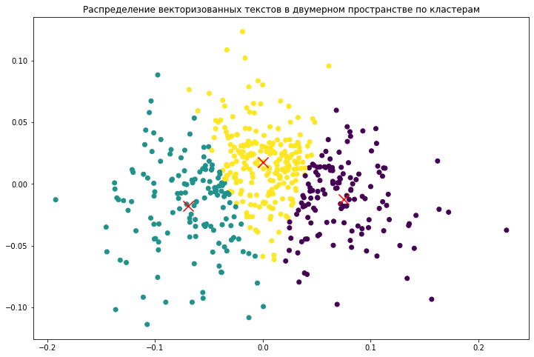
Clusters in two-dimensional space: example for CBOW
ANR-Lab
IMDB Dataset Analysis
By Davydova Violetta and Sorokina Yulia
Img. Displaying cluster tokens for the CBOW model
Img. Displaying cluster texts for the CBOW model

Slide 12
Metric Silhouette
ANR-Lab
IMDB Dataset Analysis
By Davydova Violetta and Sorokina Yulia
Модель: Pretrained. Токены
Silhouette Coefficient: 0.214
Модель: CBOW. Токены
Silhouette Coefficient: 0.507
Модель: Glove. Токены
Silhouette Coefficient: 0.623
Модель: Pretrained. Тексты
Silhouette Coefficient: 0.095
Модель: CBOW. Тексты
Silhouette Coefficient: 0.283
Модель: Glove. Тексты
Silhouette Coefficient: 0.484
Img. Metric Silhouette for tokens
Img. Metric Silhouette for texts

Slide 13
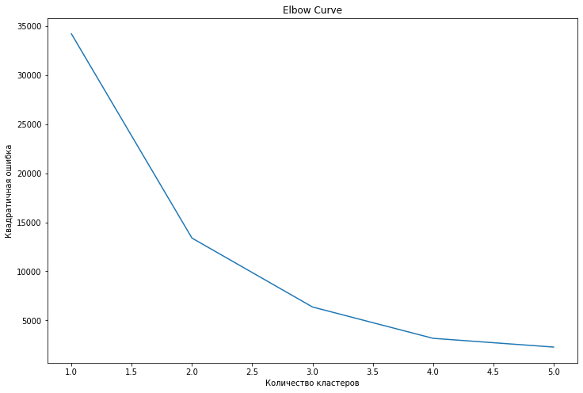
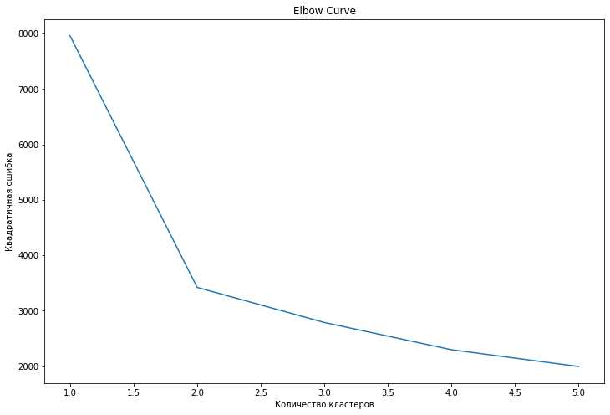
Elbow method
ANR-Lab
IMDB Dataset Analysis
By Davydova Violetta and Sorokina Yulia
Img. Elbow method for Glove model
Img. Elbow method for CBOW model

Slide 14
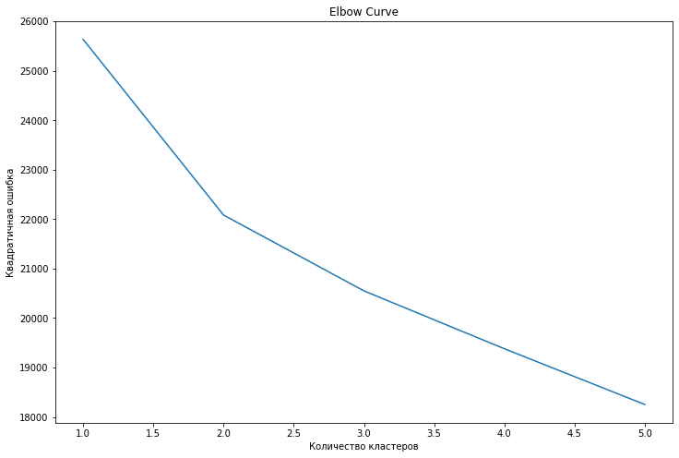
Elbow method
ANR-Lab
IMDB Dataset Analysis
By Davydova Violetta and Sorokina Yulia
Img. Elbow method for Pretrained model

Slide 15

Thanks for your attention!
everyone on these New Year's holidays favorite movies, delicious tangerines (мандарины) and 12 hours of sleep a day ... and without retaking exams ...))

